Slide 1
How to use Pathfinder to locate problem at runtime
Jan 10, 2015

Slide 2
Agenda
The shortage of Pathfinder
Enhancement
Prospect

Slide 3
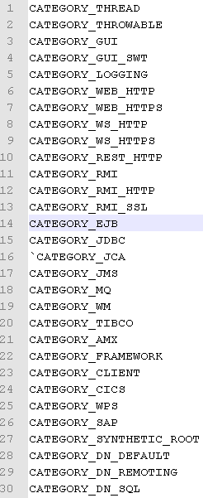
The shortage of Pathfinder
Cannot capture everything

Slide 4
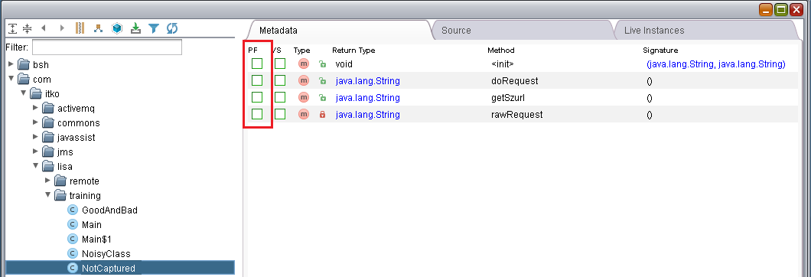
The shortage of Pathfinder
Intercept a method manually

Slide 5
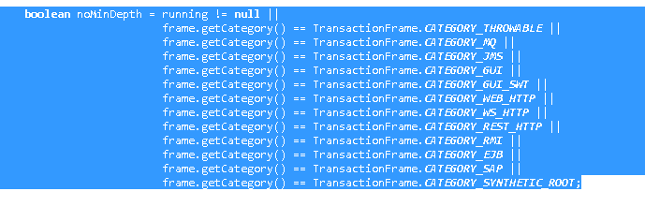
The shortage of Pathfinder
Cannot generate transaction frame by default
The root frame’s category should be:

Slide 6
Enhancement
Introduce two scenarios

Slide 7
Scenario 1
Function A
Function E
Function B
Function D
Function F
Function H
Function C
Function G

Slide 8
Scenario 1
Function A
Function E
Function B
Function D
Function F
Function H
Function C
Function G

Slide 9
SCENARIO 1
Code Inject
Function A
Function E
Function B
Function D
Function F
Function H
Function C
Function G

Slide 10
Scenario 2
Parameter 1
Function D
Return Value
Parameter 2

Slide 11
SCENARIO 2
Parameter 1
Function D
Return Value
Parameter 2
Exception

Slide 12
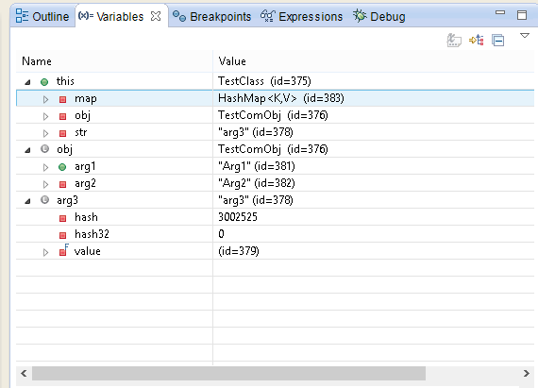
Enhancement
Just like Variables in Eclipse:

Slide 13
Demo
Message
Custom info
Call stack
Inputs
Output

Slide 14
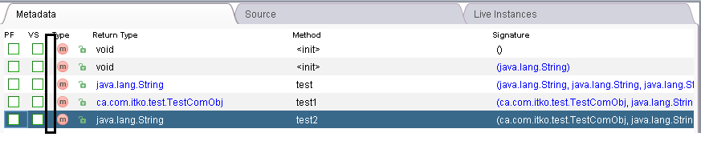
Prospect
Integrate with DevConsole
Generate JUnit test case
Using xstream to serialize the object->xml or xml->object

Slide 15
Q&A

